Slide 1
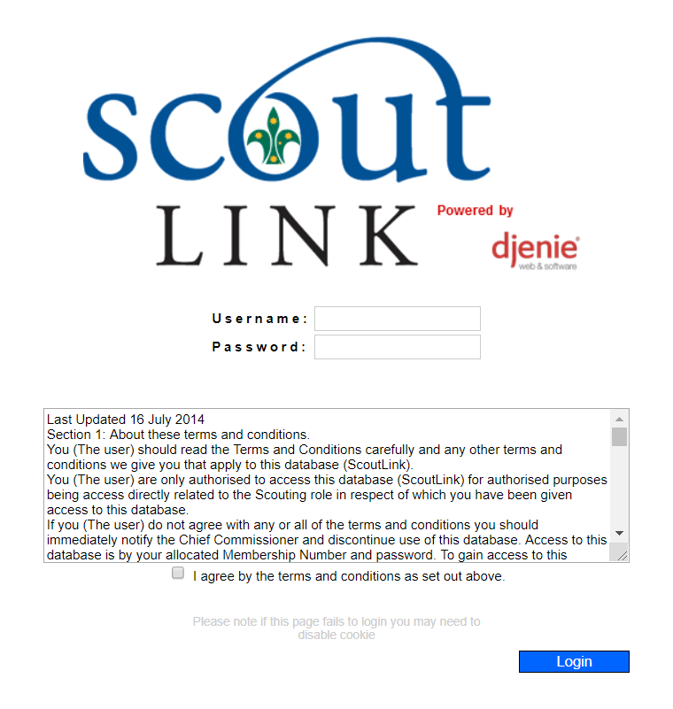
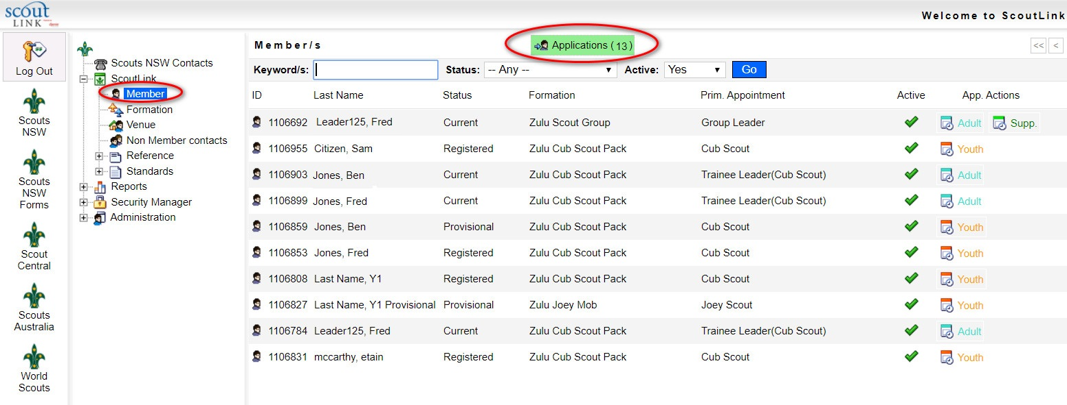
Information for Region Office Managers
How to confirm WWCC for adult membership in ScoutLink:
A1 and A2
As a Region Office Manager, you will receive an email letting you know that an applicant’s WWCC is ready for confirmation in ScoutLink. To confirm this applicant’s WWCC, follow these instructions:
Log into ScoutLink
at https://scoutlink.nswscouts.com.au
2. Choose ScoutLink menu on the left, then click Applications

Slide 2
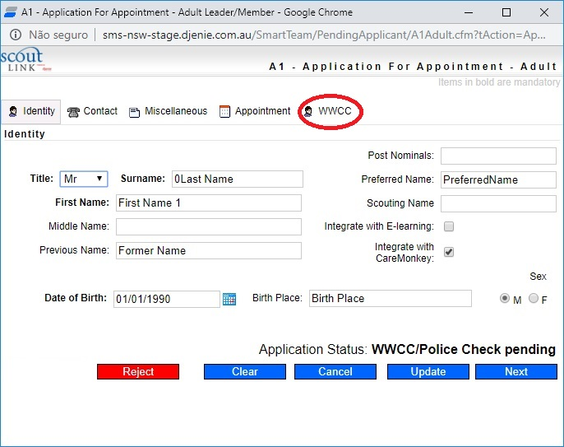
3. Choose the applicant and click Application In
4. Click on the WWCC tab

Slide 3
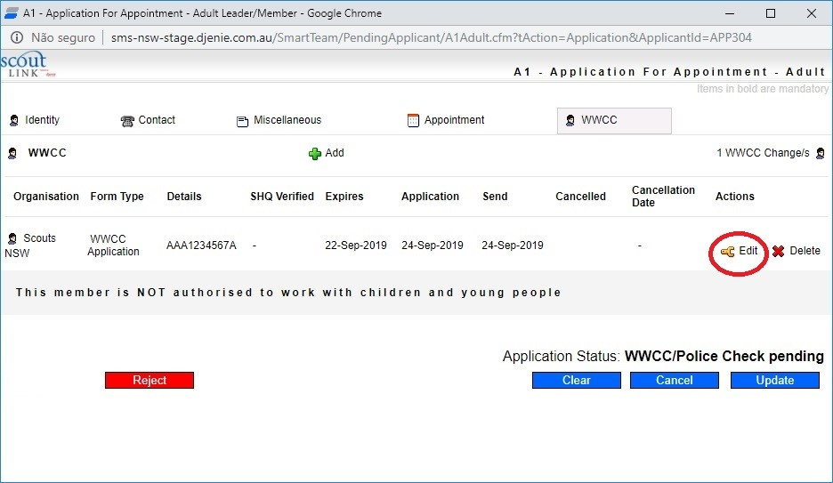
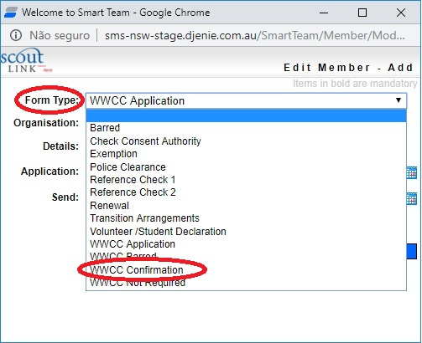
5. Click Edit
6. For a WWCC that has been APPROVED, choose the WWCC Confirmation option under the Form Type field

Slide 4
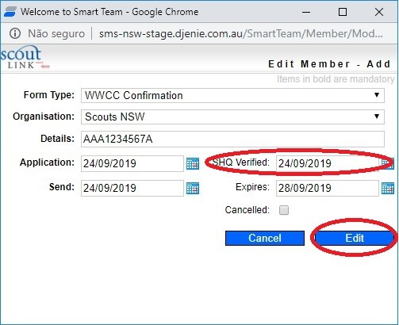
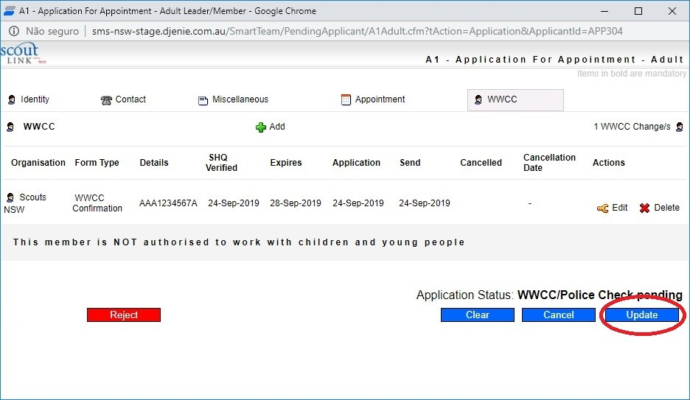
7. Enter the Scouts HQ verification date next to the SHQ Verified field, then click Edit to save your changes
8. If the WWCC was successful, click the Update button. If it was unsuccessful, click the red Reject button.
For user questions, please contact Member Services at info@nsw.scouts.com.au.
If you experience technical issues with the form, please contact the IT department at ITSupport@nsw.scouts.com.au

