Slide 1
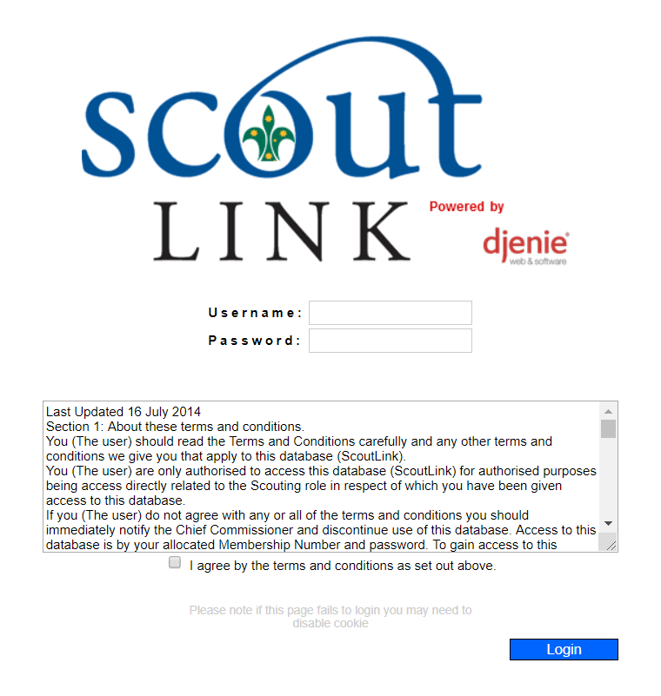
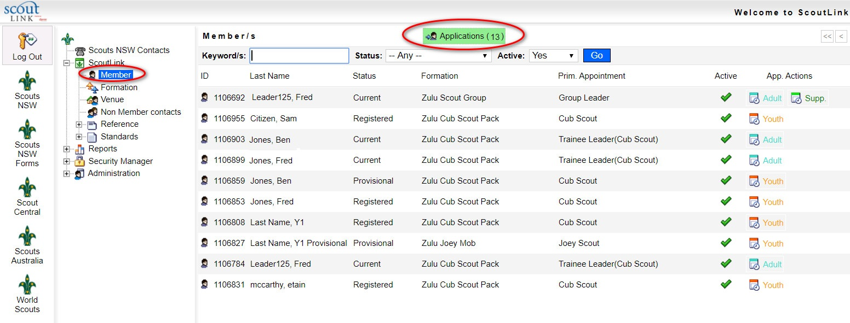
Information for Region Commissioners/District Commissioners
How to approve an application for adult membership in ScoutLink:
A1 and A2 forms
As a Region Commissioner (or District Commissioner if delegated), you will receive an email letting you know that an applicant’s details are ready for approval in ScoutLink. To approve this applicant, follow these instructions:
Log into ScoutLink
at https://scoutlink.nswscouts.com.au
2. Choose ScoutLink menu on the left, then click Applications

Slide 2
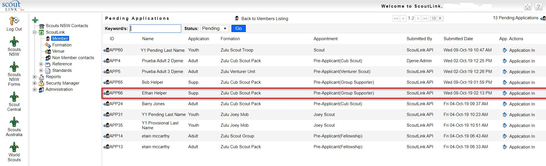
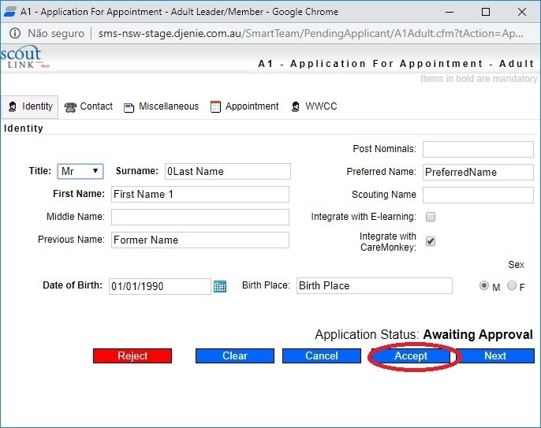
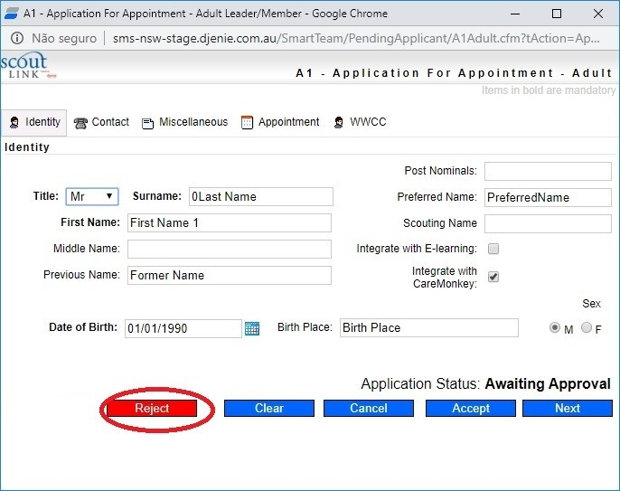
3. Choose the applicant and click Application In
OR
4. Click the Accept button to approve the application
5. Click the Reject button to refuse the application
For user questions, please contact Member Services at info@nsw.scouts.com.au. If you experience technical issues with the form, please contact the IT department at ITSupport@nsw.scouts.com.au

