Slide 1
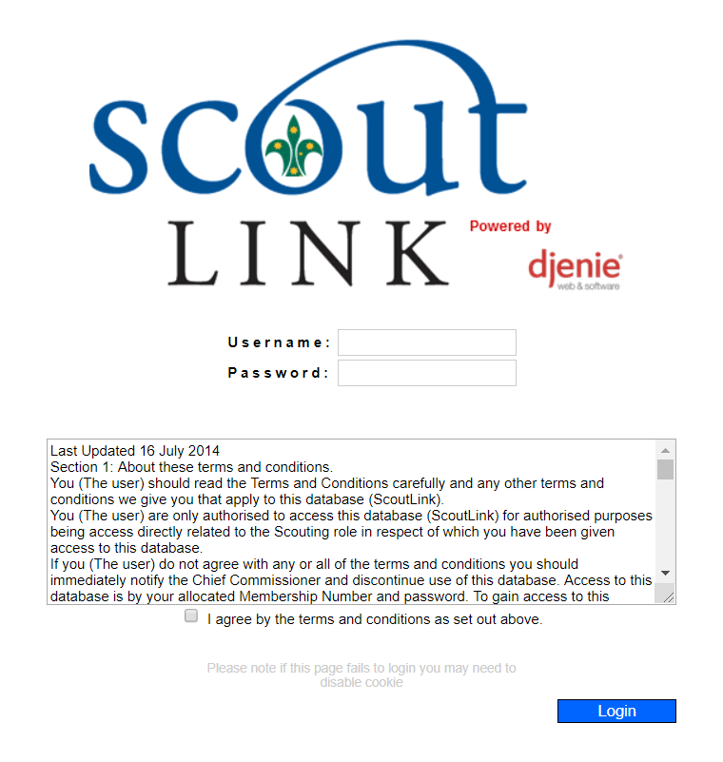
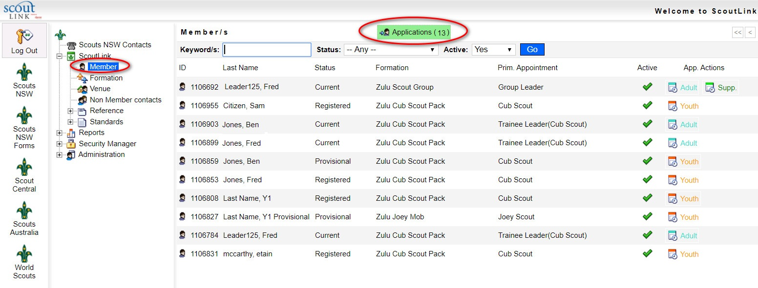
Information for Group Leaders/Leaders in Charge
How to endorse an application for adult membership in ScoutLink:
A1 and A2 forms
As a Group Leader/Leader in Charge, you will receive an email letting you know that an applicant’s details are ready for approval in ScoutLink. To endorse this applicant, follow these instructions:
Log into ScoutLink
at https://scoutlink.nswscouts.com.au
2. Choose ScoutLink menu on the left, then click Applications

Slide 2
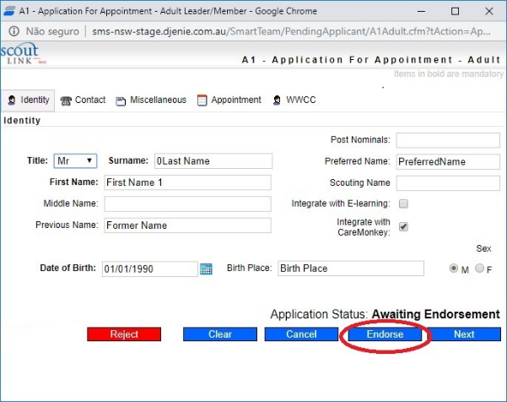
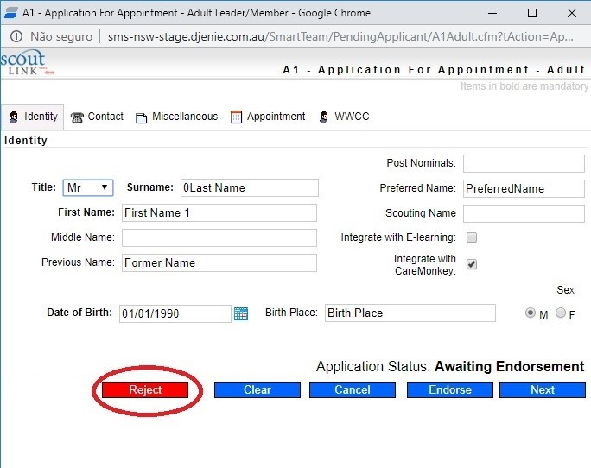
3. Choose the applicant and click Application In
4. Click the Endorse button to approve the application
OR
5. Click the Reject button to refuse the application
For user questions, please contact Member Services at info@nsw.scouts.com.au. If you experience technical issues with the form, please contact the IT department at ITSupport@nsw.scouts.com.au

